Slide 1


Waste to Electricity

Slide 2

* Team members name :
1.Rakshitha H M
2.S N Meghana
3.Kushala A K
4.Darshan K A
5.Nandan Kumar M S
6.Siddaraju M
7.Vinay Kumar G
8.Vishwas N Gowda
9.Vaibhav S
10.Sandeep S M
11.Manoj Gowda B P
E
W

Slide 3

INTRODUCTION
The main intension of this is to avoid pollution by utilizing waste for production of electricity.
A cleaner environment and less dependence on conventional resources.

Slide 4
~ Problem :
According to the survey, the total generation of municipal solid waste in 2018 was 292.4 million tons or 4.9 pounds per person per day.
As per information, municipal areas in the country generate 1, 33,760 metric tons per day of municipal solid waste of which only 91,152 TPD waste is collected and 25,884 TPD treated.
~ Problem Statement :
Utilizing waste for the production of electricity

Slide 5
~ Why analysis :
Utilization of waste
To reduce the waste material
To protect environment
To protect people from harmful diseases
To make the country development
To lead a healthy life

Slide 6
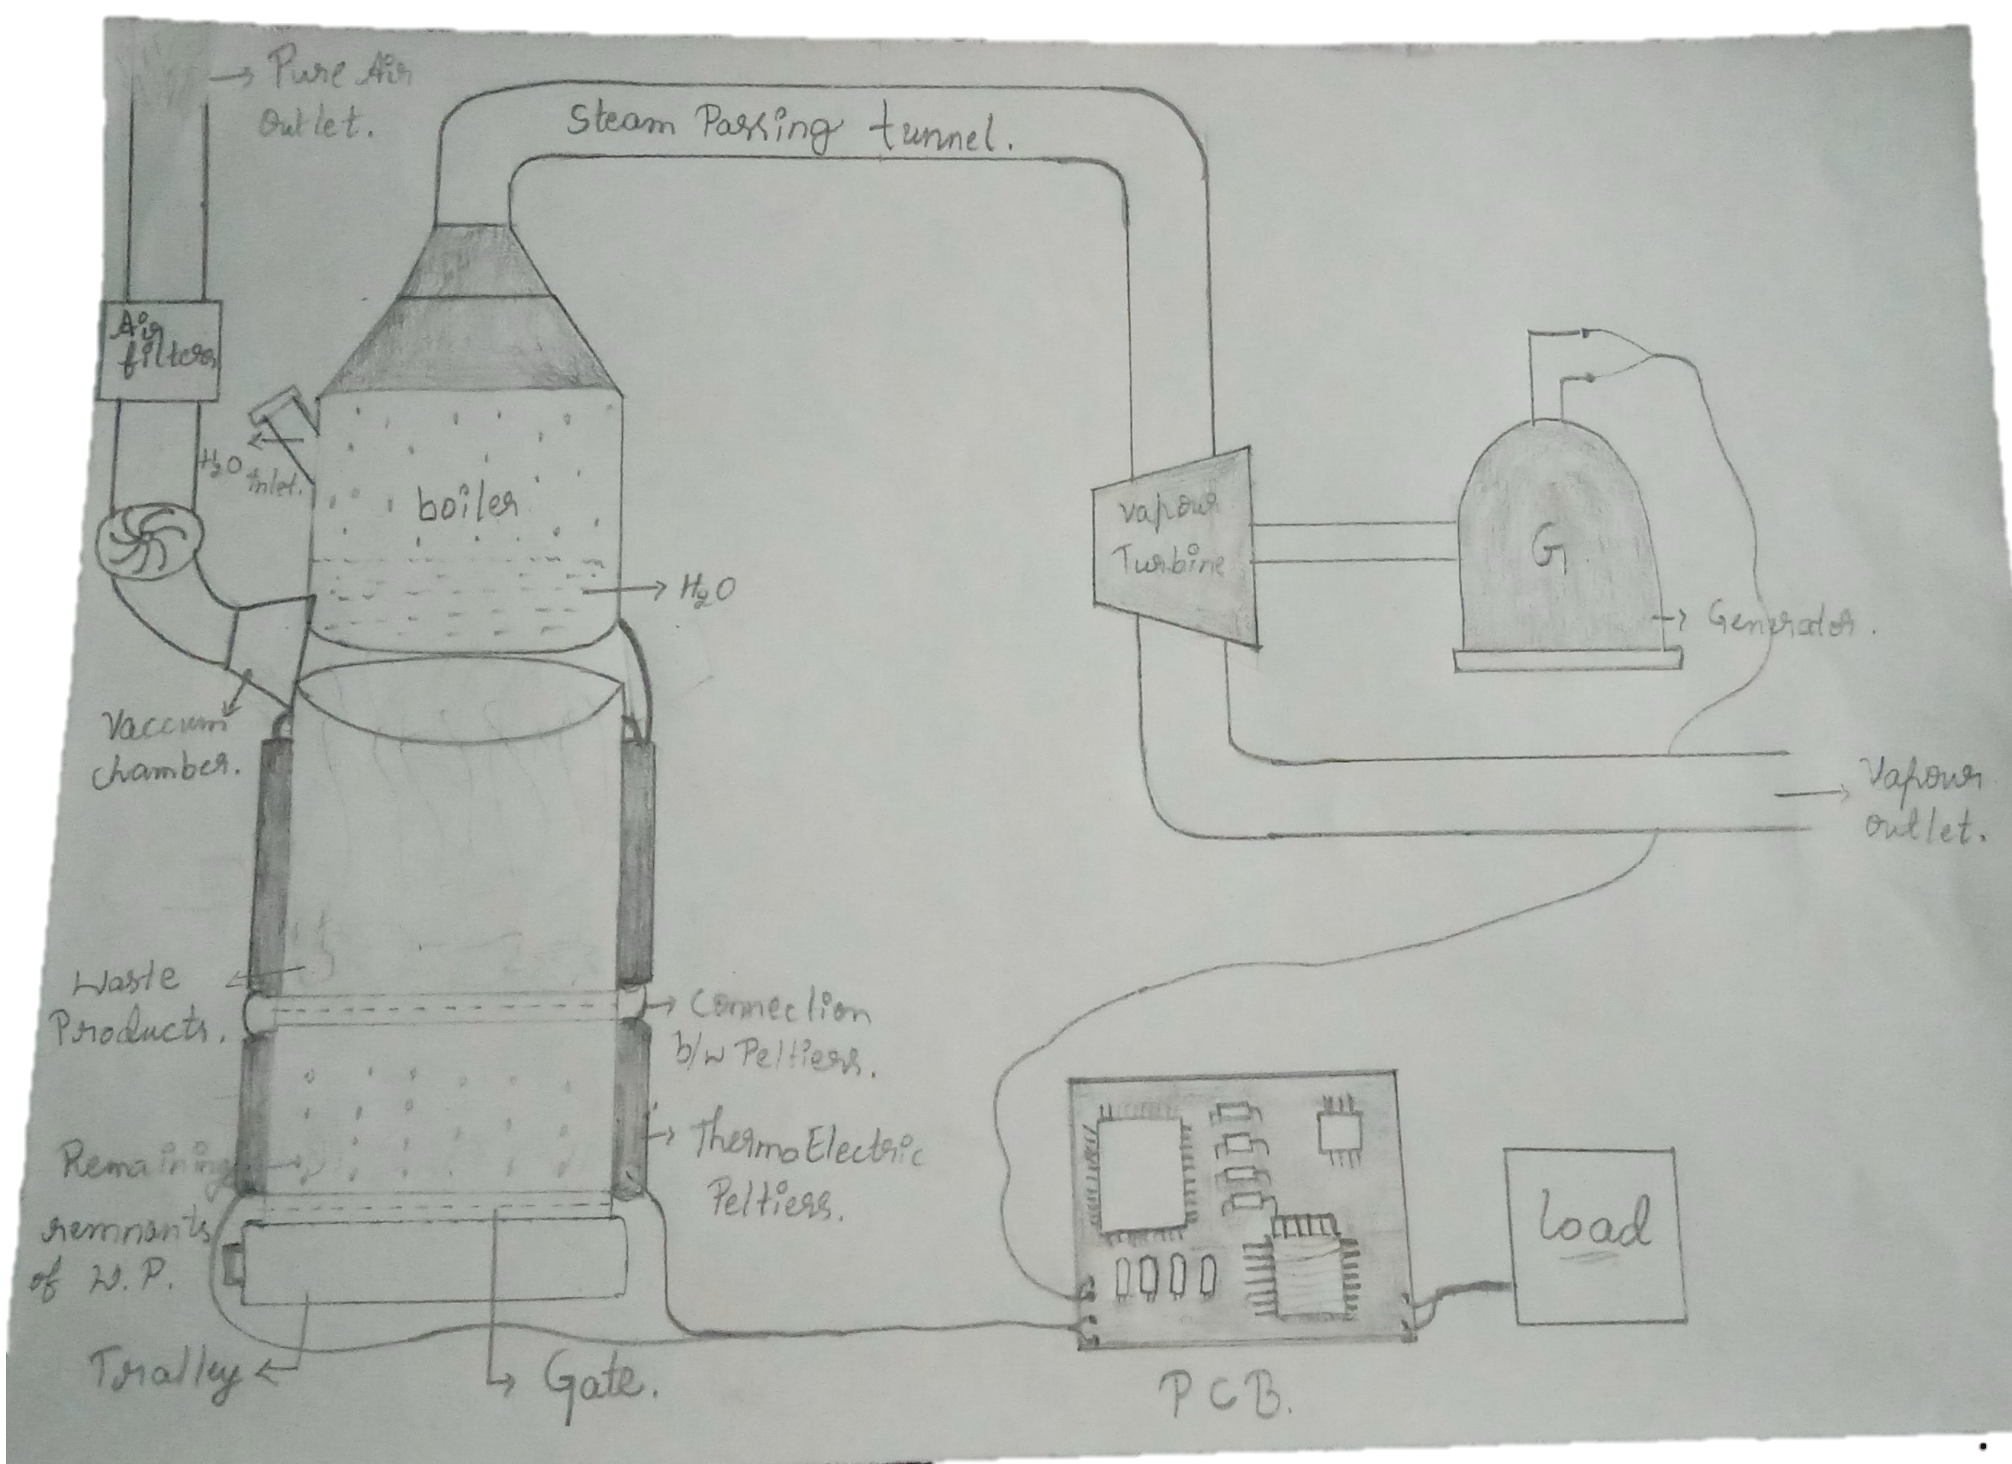
* Visualization :

Slide 7
* Components :
1.Boiler
2.Gate
3. Trolley
4. Peltier
5. Vacuum chamber
6.Air filters
7. Connection pipes
8. Vapour Turbine 9.Generator
10. PCB / Transformer
11. Wires
12. Load

Slide 8
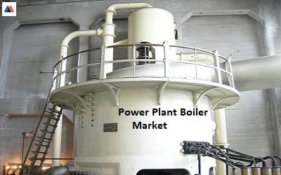
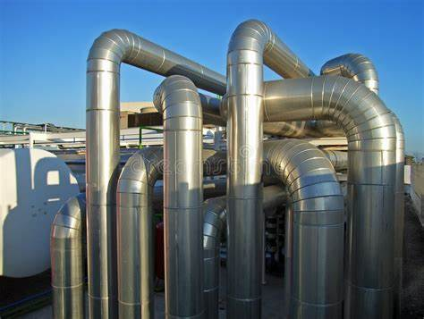
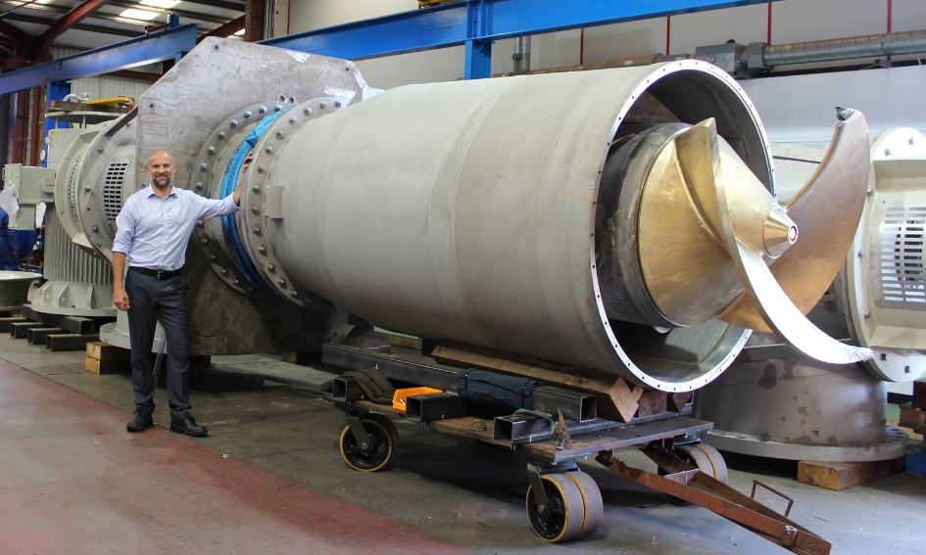
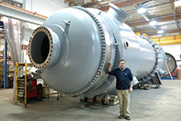
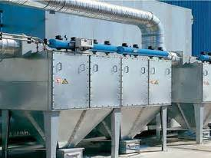
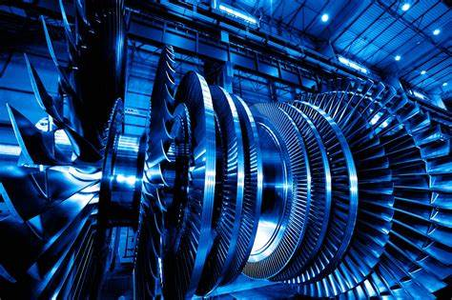
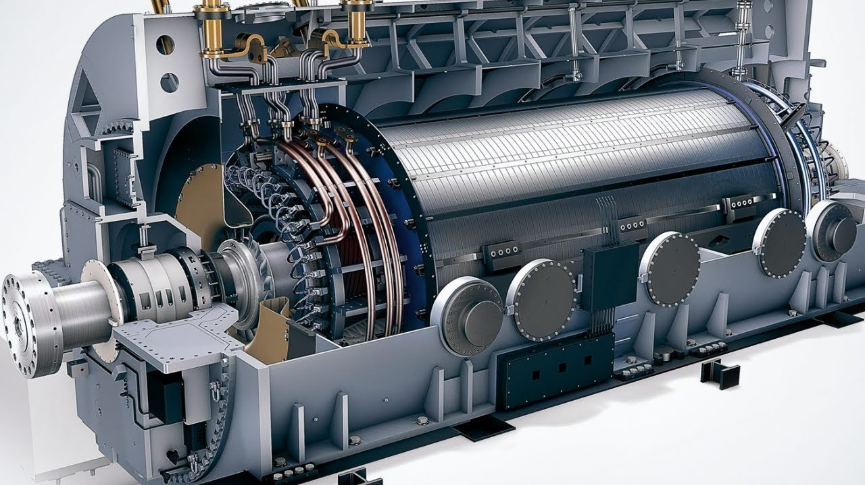
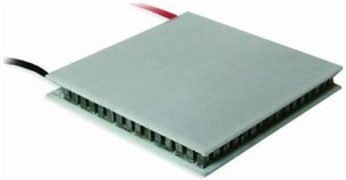

Slide 10
~ Gain Points :
* Journey Mapping :
1. Makes the environment clean and awareness among the people. 2. Reduce the dependence on other power resources.
~ Pain points :
It’s hard to segregate the waste.
Poisonous gas out come.
Installation cost is high.
~ How to Overcome the pain points :
We can collaborate with municipal for compensation
2. We can segregate the waste product by multiple process like magnetization or applying the eddy current etc.
3. Air filters and scrubbers are used to control air pollution and release a pure air.
4. Make sure that investors are more.

Slide 11
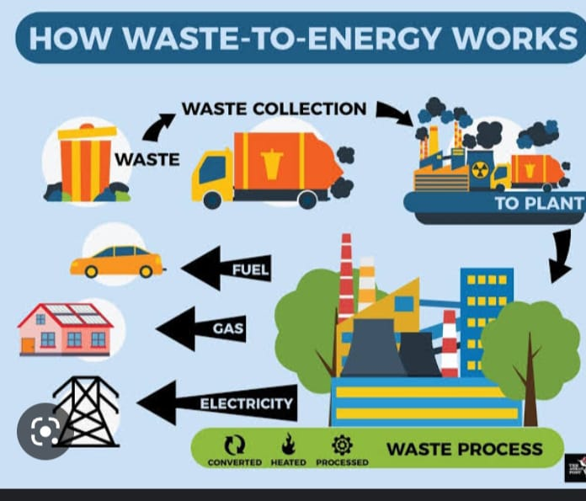
* Value Chain analysis :

Slide 12
* Mind Mapping :
Plastic / Waste Material
At the end of the day
Producing Electricity by using waste material
We and Municipal
Near Municipal waste
By installing the power plant and generate electricity by burning the waste material
To reduce the pollution and make clean city

Slide 13
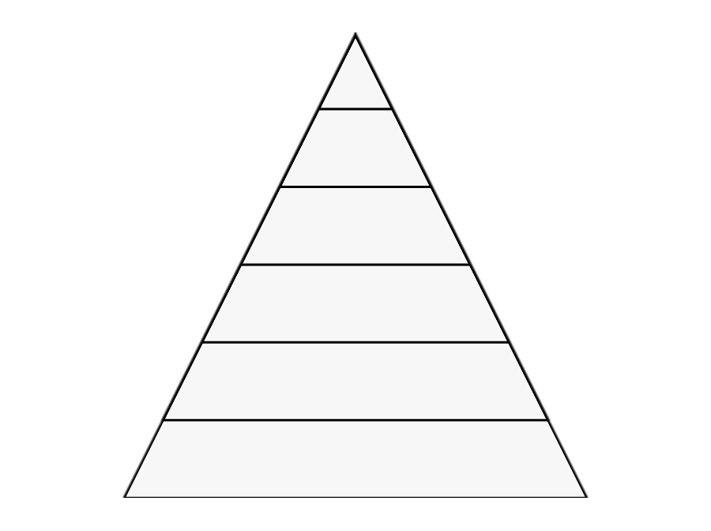
* Concept Development :
Most favoured option .
Disposal
Energy recovery
Recycling
Refuse
Minimization
Least favoured option.
Prevention

Slide 14
Main intension :
Understanding needs and insights
Where to play and how to win
Benefits
Overcome problems

Slide 15
* Customer Co ~ creation :
~ Inviting stakeholders usually customers or employees to participate in design or problem solving process to produce a mutually valued outcome
~ Benefits of customer Co – creation
* Better products based on customer desires
* Better financial performance
* The most obvious and likely best reasons to invest in co – creation is to make something new
~ New and unexpected Ideas
~ Making the customer part of the creation process
~ Removing barriers between industries

Slide 16
~ 6 Key area for customer co – creation :
1.Product innovation
2.Product improvement
3.Process improvement
4.Marketing content
5.Implementation / Launch strategy
6.Brand management

Slide 17
* Advantages of producing electricity using dry waste :
~ Production and use of energy
~ Reduction of waste going to landfills
~ utilization of by products as Tar , recycling metals
~ Avoid methane emission from landfills when burnt it
~ The benefit to local community and economy
~ Efficient waste management
~ Domestic production of energy
* Disadvantages of producing electricity using dry waste :
~ High operating cost

Slide 18

You have the power to keep India clean and better,
now we are providing that power to you.
Lightning towards Swatch Bharath :

Slide 19
Thank you from all of us

